Slide 1
BT 601: Analytical Biotechnology
-Prof. Siddhartha Sankar Ghosh
Lec-9

Slide 2
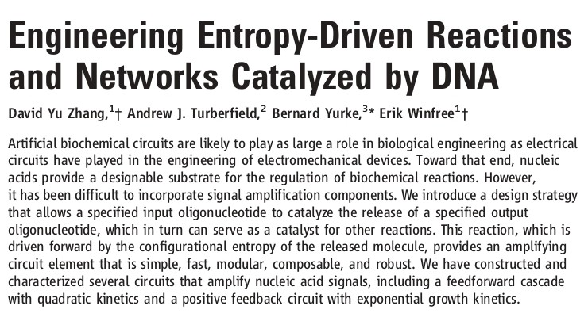

Slide 3
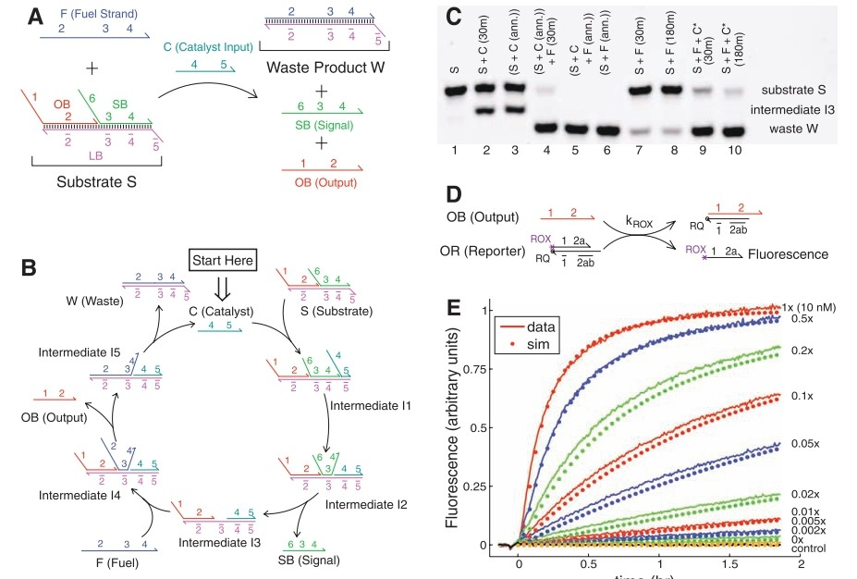

Slide 4
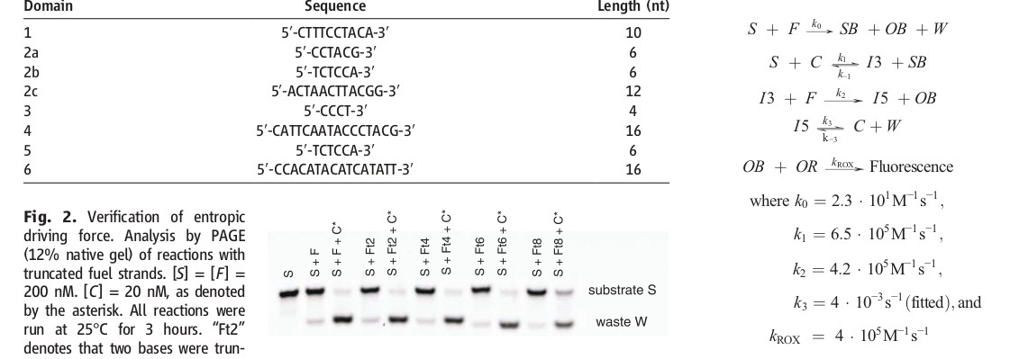

Slide 5
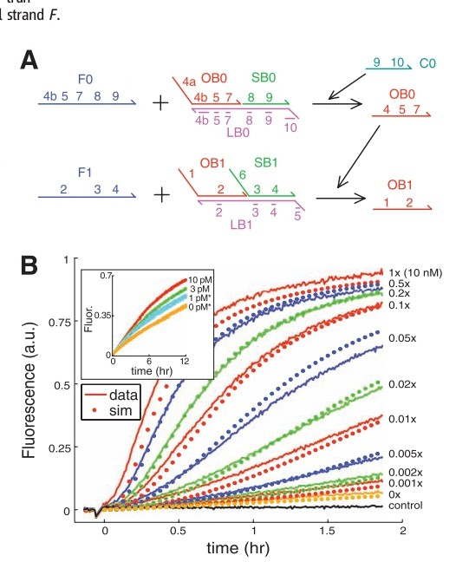

Slide 6
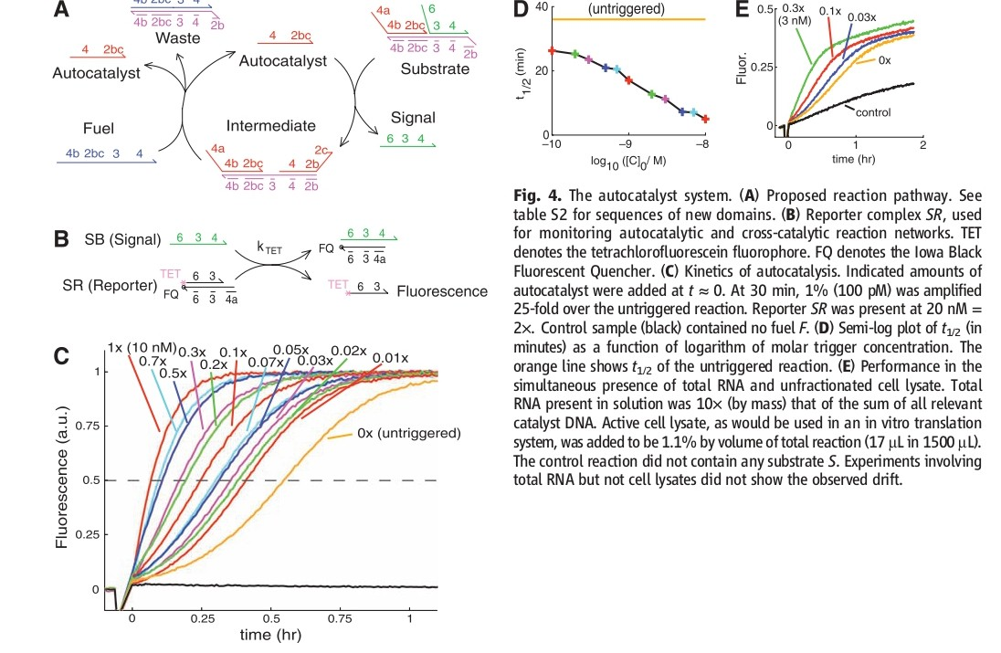

Slide 7
General principles of cell communication

Slide 8
A simple intracellular signaling pathway activated by an extracellular signal molecule.
The signal molecule usually binds to a receptor protein that is embedded in the plasma membrane of the target cell. The receptor activates one or more intracellular signaling pathways, involving a series of signaling proteins. Finally, one or more of the intracellular signaling proteins alters the activity of effector proteins and thereby the behavior of the cell.

Slide 9
Extracellular Signals Can Act Over Short or Long Distances

Slide 10
Four forms of intercellular signaling
Contact-dependent signaling requires cells to be in direct membrane–membrane contact.
Paracrine signaling depends on local mediators that are released into the extracellular space and act on neighboring cells.
Synaptic signaling is performed by neurons that transmit signals electrically along their axons and release neurotransmitters at synapses, which are often located far away from the neuronal cell body.
Endocrine signaling depends on endocrine cells, which secrete hormones into the bloodstream for distribution throughout the body. Many of the same types of signaling molecules are used in paracrine, synaptic, and endocrine signaling; the crucial differences lie in the speed and selectivity with which the signals are delivered to their targets.

Slide 11
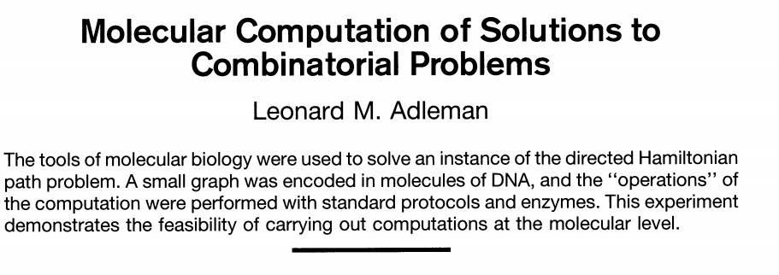

Slide 12
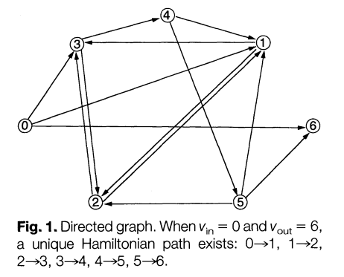

Slide 13
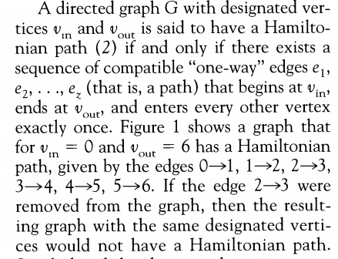

Slide 14
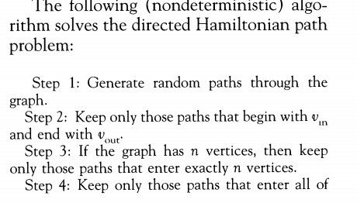


Slide 15
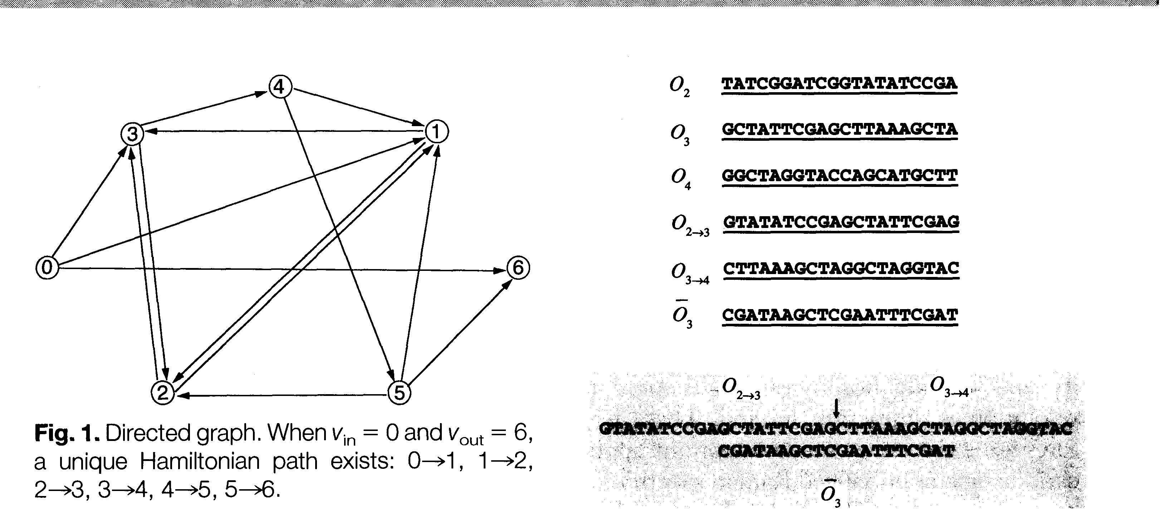

Slide 16
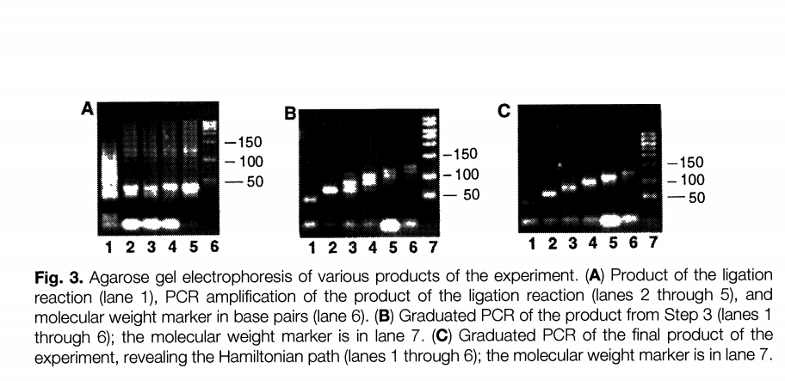

Slide 17
THANK YOU

